Slide 1
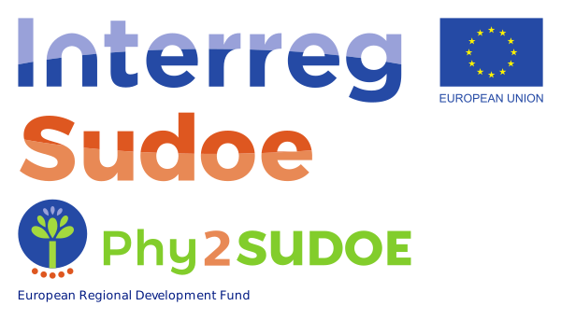
RECOVERING CONTAMINATED SOILS THROUGH PHYTOMANAGEMENT IN SOUTHWEST EUROPE
TITLE: XXXXXXXXXXXXXXXXXXX (Arial 48)
AUTHOR: XXXXXXXXXXXXXXXX
AFFILIATION: XXXXXXXXXXXXXXXXXXXXX (Arial 40)
INTRODUCTION
XXXXXXXXXXXXXXXXXXXXXXXXXXXXXXXXXXXXXXXXXXXXXXXXXXXXXXXXXXXXXXXXXXXXXXXXXXXXXXXXXXXXXXXXXXXXXXXXXXXXXXXXXXXXXXXXX
(ARIAL 32)
OBJECTIVES
XXXXXXXXXXXXXXXXXXXXXXXXXXXXXXXXXXXXXXXXXXXXXXXXXXXXXXXXXXXXXXXXXXXXXXXXXXXXXXXXXXXXXXXXXXXXXXXXXXXXXXXXXXXXXXXXX
(ARIAL32)
METHODOLOGY
XXXXXXXXXXXXXXXXXXXXXXXXXXXXXXXXXXXXXXXXXXXXXXXXXXXXXXXXXXXXXXXXXXXXXXXXXXXXXXXXXXXXXXXXXXXXXXXXXXXXXXXXXXXXXXXXX
(ARIAL32)
RESULTS
XXXXXXXXXXXXXXXXXXXXXXXXXXXXXXXXXXXXXXXXXXXXXXXXXXXXXXXXXXXXXXXXXXXXXXXXXXXXXXXXXXXXXXXXXXXXXXXXXXXXXXXXXXXXXXXXX
(ARIAL32)
GENERAL TABLE (arial 28) | Text | Text | Text
Text | Text | Text | Text
Text | Text | Text | Text
CONCLUSIONS
XXXXXXXXXXXXXXXXXXXXXXXXXXXXXXXXXXXXXXXXXXXXXXXXXXXXXXXXXXXXXXXXXXXXXXXXXXXXXXXXXXXXXXXXXXXXXXXXXXXXXXXXXXXXXXXXX
(ARIAL32)
BIBLIOGRAPHY
XXXXXXXXXXXXXXXXXXXXXXXXXXXXXXXXXXXXXXXXXXXXXXXXXXXXXXXXXXXXXXXXXXXXXXXXXXXXXXXXXXXXXXXXXXXXXXXXXXXXXXXXXXXXXXXXX
(ARIAL32)
Phy2SUDOE project (SOE4/P5/E1021) is financed by the Interreg Sudoe Programme through the European Regional Development Fund (ERDF).

